Slide 1
Registrars Salary and Travel Reimbursement
(FY-2026)
Walter Dulaney
Revised: 11-2025

Slide 2
Code of Alabama
Section 17-3-5 details registrar compensation, however there are other sections, chapters and articles that pertain to registrars
The State Comptroller is responsible for reimbursing counties for registrar salary and travel compensation
  The State Comptroller is responsible for verifying and auditing registrar reimbursement requests to ensure enough information is provided to ensure compliance with the code of AL
  The Secretary of State (SOS) is also involved in this process, and the State Comptroller works closely with SOS to ensure the code of AL is adhered to

Slide 3
Basics – Salary Pay
County registrar numbers range from 1 to 4 registrars, depending on the county
A Quorum MUST be met for the State Comptroller to reimburse the county
In general, registrars can only claim workdays on a day the county courthouse is open for the county, with very few exceptions
In general, weekends and non-state holidays are not reimbursable
Labels W, H, P, A, I, and L are eligible for salary reimbursement
Label T is not eligible for salary reimbursement

Slide 4
Salary Packet Required Forms
Reimbursement Voucher for Board of Registrars
  Must be signed
BOR Attendance Report
  Must be signed with original signatures by the registrars
  A Quorum must be met
*** Please note, these forms may be updated from time to time and may look differently ***

Slide 5
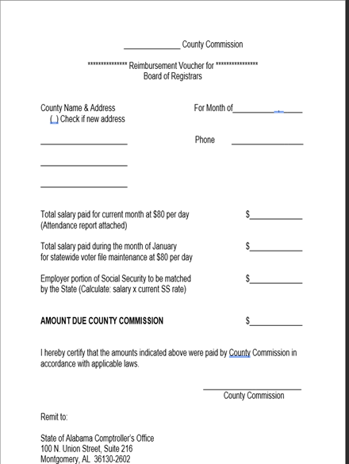
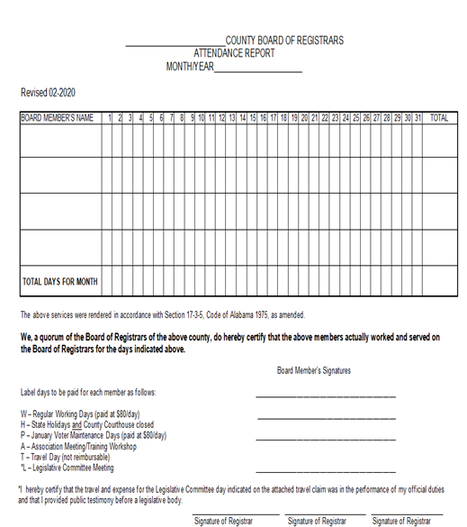
Examples of the Required Forms

Slide 6
Label: W – Salary Pay
W – Regular Working Day
County courthouse must be open along with the registrar's office
  Certain situations may result in an exception, such as if the county courthouse is closed but the building the registrars work in is separate from the courthouse and is still open to the public.
Paid at $115 per day (Effective October 1, 2025)
Notes:
ACT 2025-22 increased BOR pay from $80 to $115

Slide 7
Label: H – Salary Pay
H – Holiday
Must be a State holiday and the county courthouse must be closed.
  Holiday CANNOT just be a county holiday and must be a state designated holiday
Paid at $115 per day (Effective October 1, 2025)

Slide 8
Label: H – State Holidays
New Year’s Day
Martin Luther King Jr. birthday / Robert E. Lee birthday
George Washington birthday / Thomas Jefferson birthday
Confederate Memorial Day
National Memorial Day
Jefferson Davis’ birthday
Juneteenth Day
Fourth of July / Independence Day
Labor Day
Columbus Day / Fraternal Day / American Indian Heritage Day

Slide 9
Label: H – State Holidays (cont.)
Veterans’ Day
Thanksgiving (as designation by the Governor)
Christmas Day
Special exceptions / designations:
  Mardi Gras (Baldwin and Mobile Counties Only)
  Mrs. Rosa L. Parks Day (Commemoration Only)

Slide 10
Label: P – Salary Pay
P – Purge / Voter Maintenance
Only applicable in January
Does not count against the working days of a registrar, for reimbursement purposes
Paid at $115 per day (Effective October 1, 2025)
PLEASE NOTE: Any labels other than P, for January, will count against the total working days for the registrar for the year. Be sure to use the correct label in January

Slide 11
Label: A – Salary Pay
A – Association Meeting / Training Days
Travel compensation eligible
Will be cross referenced against registrar travel forms, in addition to sign in sheets for that meeting (Must be signed by all registrars who attend)
Not all registrar ‘meetings’ meet the criteria for association meeting / training
  Training/meeting must be needed in order for the registrar to perform their duties
  Most, if not all, will have a sign in sheet that MUST be signed
Paid at $115 per day (Effective October 1, 2025)

Slide 12
Label: I – Salary Pay
I – Independent Training / Mentoring
  Will most likely be used if a registrar from one county goes to another county to aid in training other registrars
Travel compensation eligible
Cross referenced against registrar travel forms
Paid at $115 per day (Effective October 1, 2025)

Slide 13
Label: L – Salary Pay
L – Legislative Committee Meeting
Travel compensation eligible
Cross referenced against registrar travel forms, if applicable
Legislative agenda MUST be attached with reimbursement request
Paid at $115 per day(Effective October 1, 2025)

Slide 14
Label: T
T – Travel Day
  Used for days when a registrar did not perform work and did not attend training, but did travel
NOT eligible for salary reimbursement, only eligible for travel compensation
Dates must agree with travel request forms

Slide 15
Basics – Travel Compensation
Dates, points of travel, mileage, hours of departure and hours of return must be detailed and legible
Agenda is needed for reimbursement, when applicable
If lesser than per diem is claimed, registrar must sign the signature line indicating such on the reimbursement claim form as well
Labels A, I, T, and L are eligible for travel reimbursement

Slide 16
Per Diem vs. Actual Expense
Per Diem – capped reimbursement established upon certain criteria.
  Based on how a regular State employee is reimbursed
  Tends to be simpler
Actual Expense – reimbursement based on what was actually expensed for travel
  Tends to be more complex and more involved
  More forms to fill out, and must be filled out in a specific manner
ONLY ONE OF THESE TWO OPTIONS CAN BE CLAIMED WHEN REQUESTING TRAVEL REIMBURSEMENT

Slide 17
Per Diem
Travel greater than 6 hours but less than 12 hours = $12.75
Travel greater than 12+ hours but less than overnight = $34.00
Only one overnight stay = $85 per day
  Will result in a total of $170 of per diem
More than one overnight stay = $100 per day

Slide 18
Actual Expenses
Non-overnight travel (day travel) NOT eligible
Requirements are the same as State employees
Travel expenses must be estimated and approved by the county prior to travel
Once the travel has concluded, actual travel expenses must be recorded, and approved for reimbursement by the county and sent to the State Comptroller
Both forms, signed, must be sent with the travel reimbursement request

Slide 19
Mileage
Based upon what a state employee would be reimbursed for traveling in their own personal vehicle OR what a county employee would be reimbursed for traveling in their own personal vehicle (Whichever is greater)
  State mileage rate: $0.70 per mile (Starting January 1, 2025)
Mileage Rate Changes periodically
https://comptroller.alabama.gov/mileage-rates/

Slide 20
Per Diem Required Forms
Per Diem Only
  Reimbursement Travel Voucher for Board of Registrars
    Must be signed
  Board of Registrars Travel Reimbursement Claim
    Must be Signed

Slide 21
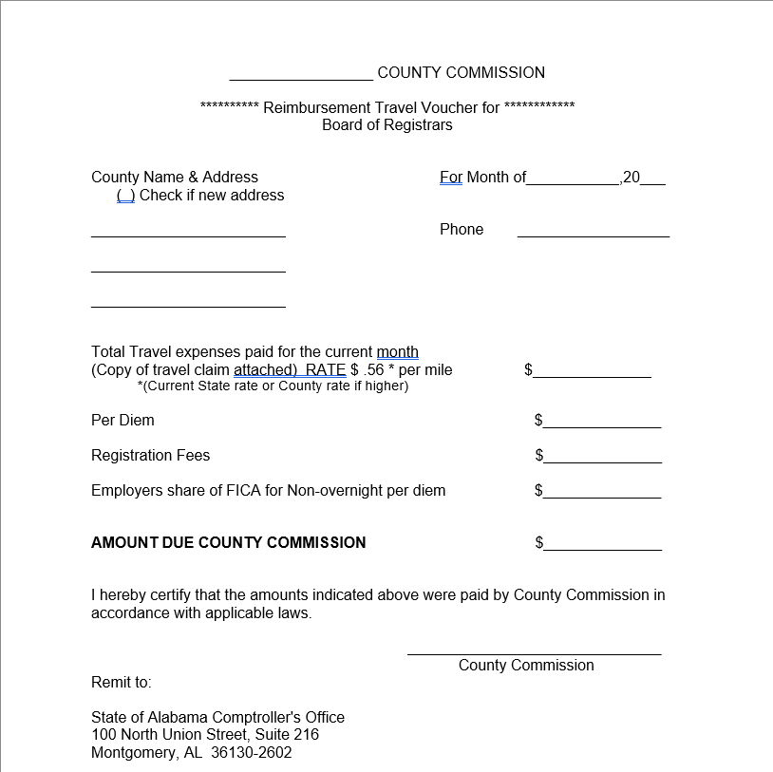
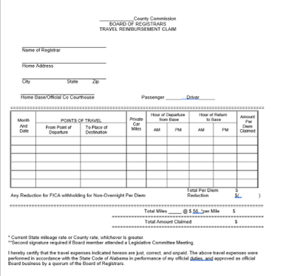
Examples of Per Diem Forms

Slide 22
Actual Expense Required Forms
Actual Expenses Only
  Preapproval actual expense form
    Must be signed
  Post approval actual expense form
    Must be signed
  Receipts and/or proof of payment

Slide 23
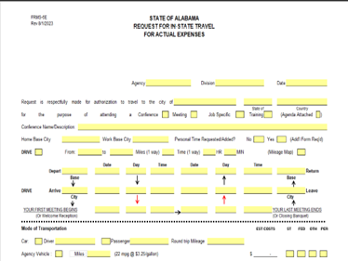
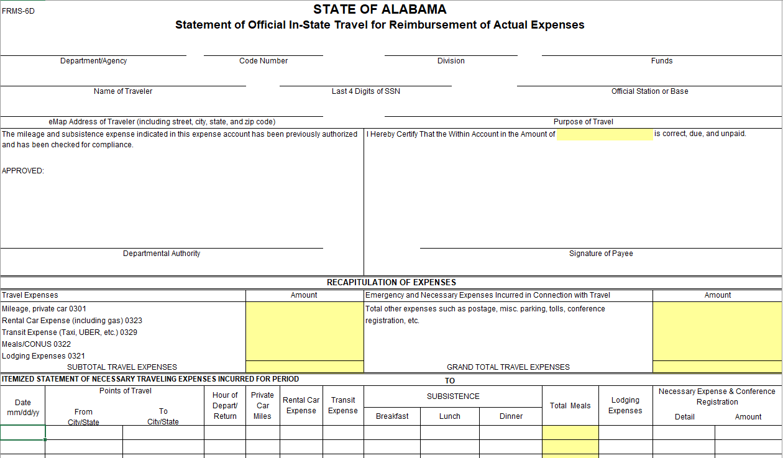
Examples of Actual Expense Forms

Slide 24
Label: A – Travel Compensation
A – Association Meeting / Training
Cross referenced against the BOR Attendance Report, in addition to the sign in sheets
Meeting agenda must be included with reimbursement request
Dates on travel claim must match the attendance report dates
Label indicator must be marked at top right on the travel claim

Slide 25
Label: I – Travel Compensation
I - Independent Training / Mentoring
Cross referenced against BOR Attendance Report
Dates on travel claim must match the attendance report dates
Comment must be included, summarizing the type of training and which counties were involved in the session, in the travel claim comments section
Label indicator must be marked at top right on the travel claim

Slide 26
Label: T – Travel Compensation
T – Travel Day
Cross referenced against BOR Attendance Sheet
Label T IS NOT eligible for salary reimbursement, but is reimbursable for travel compensation

Slide 27
Label: L – Travel Compensation
L – Legislative Committee Meeting
Cross referenced against BOR Attendance Sheet
Dates on travel claim must match the attendance report dates
Legislative agenda must be attached with reimbursement request
Must sign the legislative committee day signature line on the travel claim
Label indicator must be marked at top right on the travel claim

Slide 28
Ongoing Updates / Projects
As changes are made to the code of AL, the State Comptroller will do its best to update this document to ensure registrars have a resource to stay informed and to reference
One major change that will be completed in the future is the move toward a more direct communication and reimbursement request system done through an electronic system called Submittable
  This will allow counties to directly submit their reimbursement requests to the comptroller online for quicker processing and feedback on requests

